Slide 1
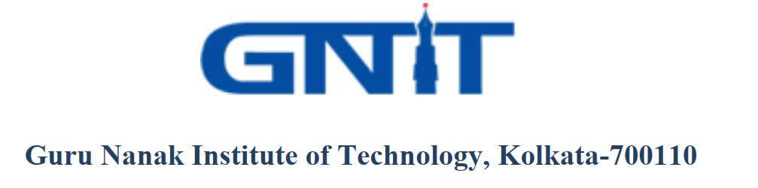
FORECASTING OF CUSTOMER BEHAVIOUR BY PREDICTIVE ANALYSIS OF SALES DATA
ROLL NO: 502120011002
STUDENT NAME: DEBASISH DHAR Under the guidance of Dr. SANGEETA BHATTACHARYA Computer Science & Engineering Department

Slide 2
PROBLEM STATEMENT
An Electronics store has last 12 months of sales data which contains numerous electronics store purchases broken down by month, product type, cost, customer name, purchase address, etc. The corporation needs data scientists to analyse the sales data and forecast the key buying decisions of potential customers.

Slide 3
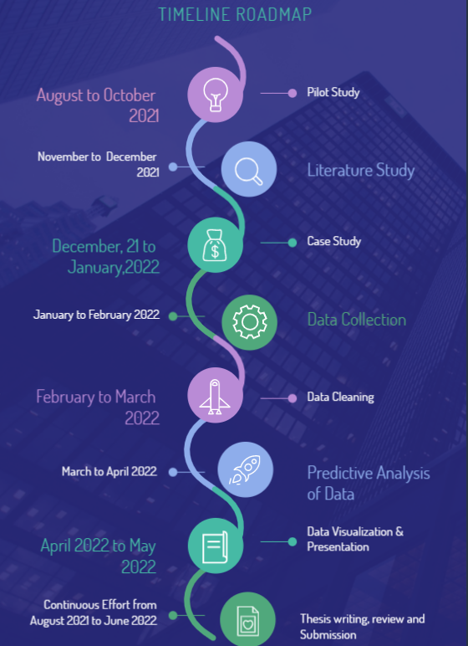
PROPOSED APPROACH
STEPS INVOLVED IN THE THESIS:
PILOT STUDY
LITERATURE SURVEY
CASE STUDY
DATA COLLECTION
DATA CLEANING
PREDICTIVE ANALYSIS OF DATA
THESIS WRITING, REVIEW & SUBMISSION

Slide 4
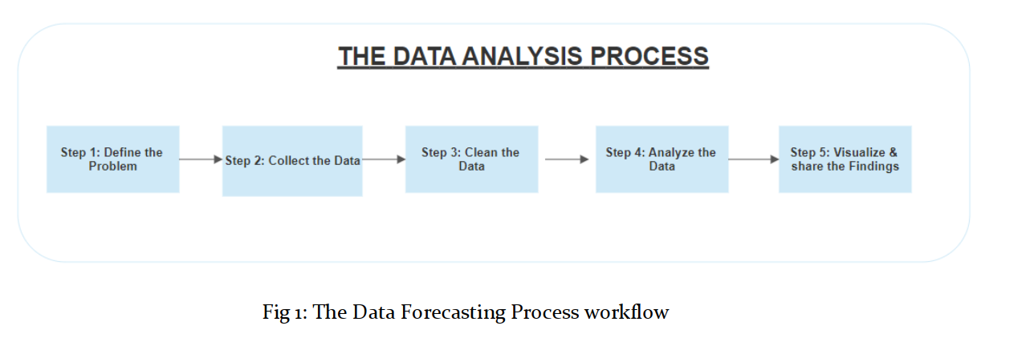
Step 1: Define the Problem
Step 2: Collect the data
Step 3: Clean the Data
Step 4: Analyze the Data
Step 5: Visualize & share the findings

Slide 5
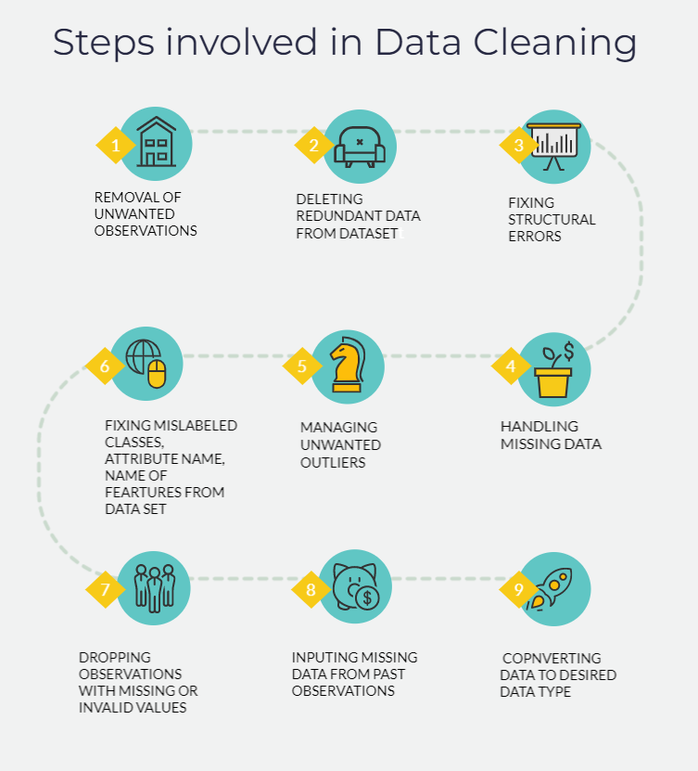
DATA CLEANING

Slide 6
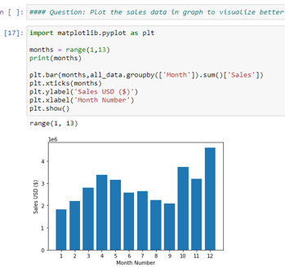
RESULTS
Problem 1: To find out what was the best months for sales and how much money was earned by the company in that month.

Slide 7
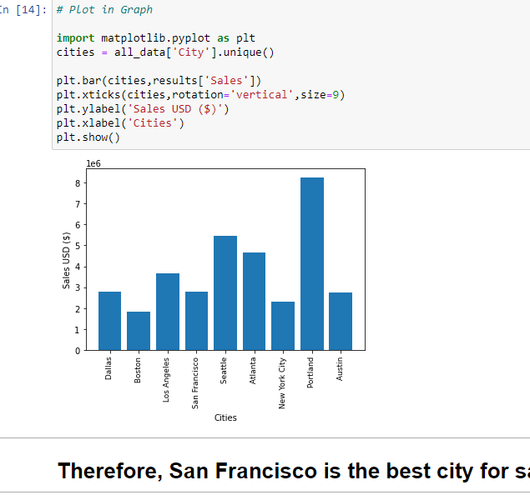
RESULTS
Problem 2: To find out which city had the highest number of sales

Slide 8
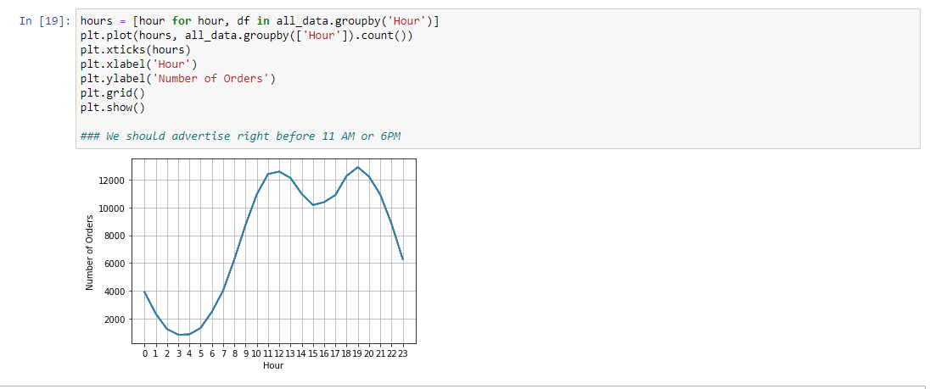
RESULTS
Problem 3: To find out what time should we display advertisements to maximize the like hood of the customer's buying the product.

Slide 9
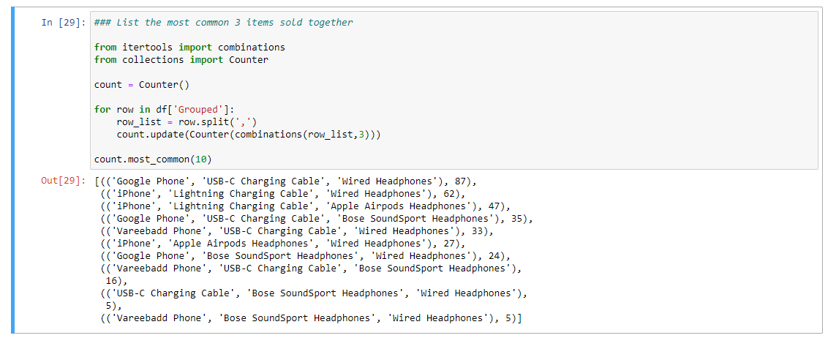
RESULTS
Problem 4: To find out which products are most often sold together?

Slide 10
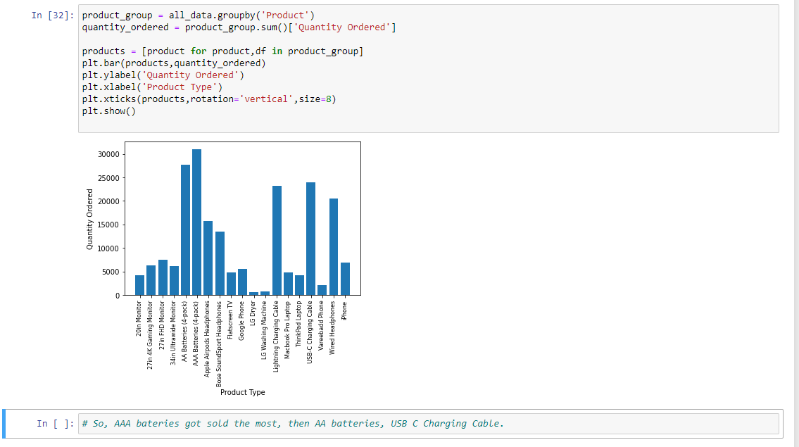
RESULTS
Problem 5: To find out what products were sold the most.

Slide 11
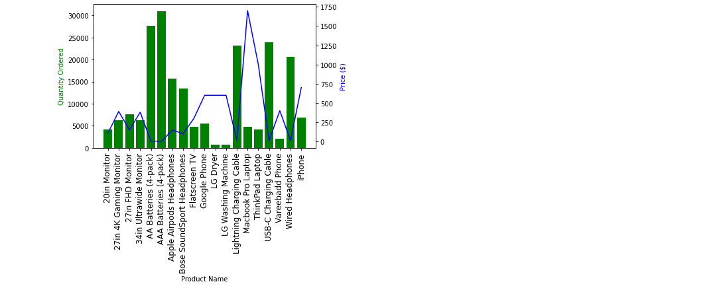
RESULTS
Problem 6: To understand the reason behind the product which got sold the most.

Slide 12
CONCLUSION & FUTURE STUDY
FOR THE IMPLEMENTATION, WE HAVE UTILISED THE PYTHON PROGRAMMING LANGUAGE. FOR DETAILED INVESTIGATION, WE UTILISED A JUPYTER NOTEBOOK. DIFFERENT PYTHON LIBRARY PACKAGES HAVE BEEN USED FOR DATA ANALYSIS. USING VARIOUS PARAMETERS, WE WERE ABLE TO GET THE DESIRED RESULT.
This thesis presents a further scope of future study using additional data sets and more functions in the future to acquire a more vivid picture of predictive data analysis.

